Slide 1
Advanced React Patterns & Performance (2026)
Building Scalable and Maintainable Applications
Presenter: Kanchan Sontakke

Slide 2
Agenda
Why scalability & performance matter
Modern React mental model
Advanced component patterns
State management strategies
Performance optimization techniques
Architecture & maintainability
Anti-patterns
Key takeaways

Slide 3
Why This Topic Matters
Growing complexity in large React apps
Performance bottlenecks in production systems
Maintainability challenges over time
Need for scalable architectural patterns

Slide 4
React Mental Model (2026)
Declarative UI approach
Composition over inheritance
Components → UI responsibility
Hooks → Logic responsibility
Predictable data flow

Slide 5
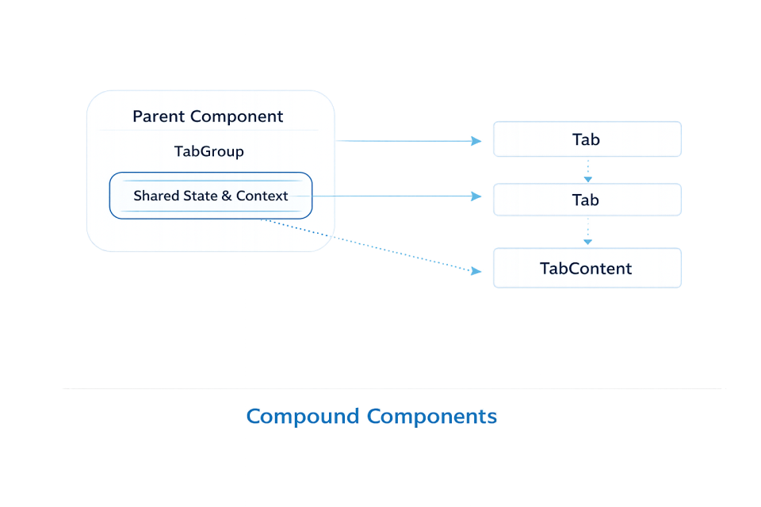
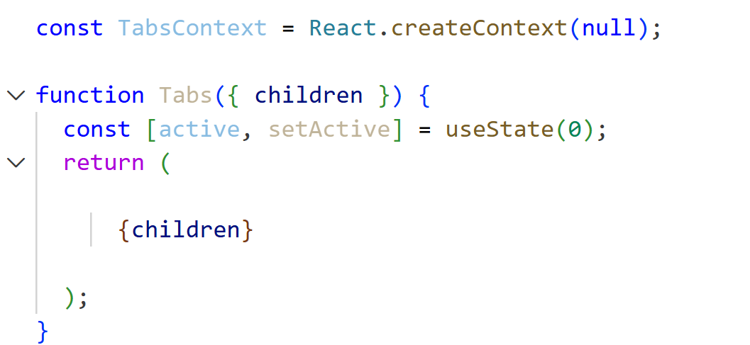
Advanced Component Patterns Overview
Compound Components
Controlled vs Uncontrolled Components
Render Patterns (Selective usage)
Goal: Flexible & readable component APIs

Slide 6
Compound Components
Shared internal state
Flexible consumer APIs
Improves readability & scalability
Use Cases: Tabs, Accordions, Modals

Slide 7
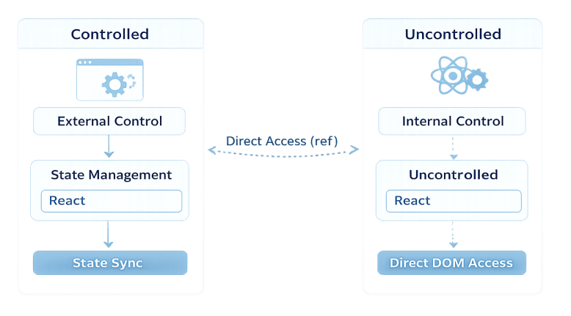
Controlled vs Uncontrolled Components
Controlled: External state management, Predictable behavior
Uncontrolled: Internal component state, Simpler usage
Choosing depends on Reusability, Complexity, Consumer flexibility

Slide 8
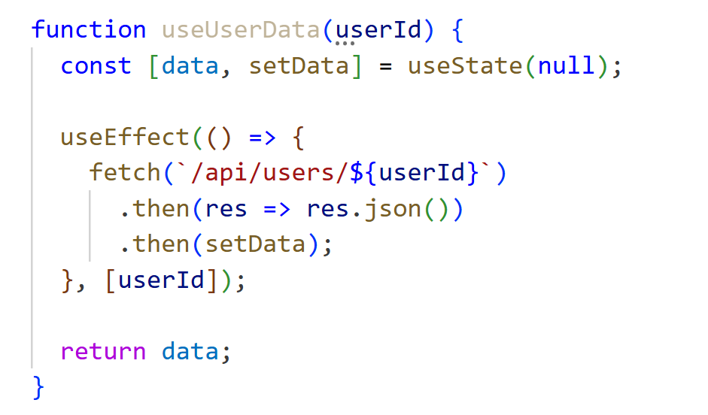
Custom Hooks as Scaling Strategy
Encapsulate business logic
Improve reuse
Simplify components
Improve testability

Slide 9
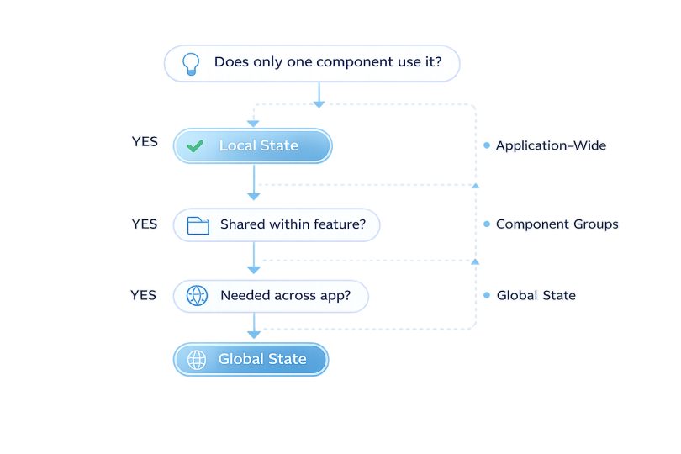
State Management Strategy
Local state first
Lift state only when required
Global state only when shared broadly
Principle: Not all state deserves to be global

Slide 10
React Performance Fundamentals
What triggers re-renders
Parent → child rendering relationship
Importance of reference stability
Measuring before optimizing

Slide 11
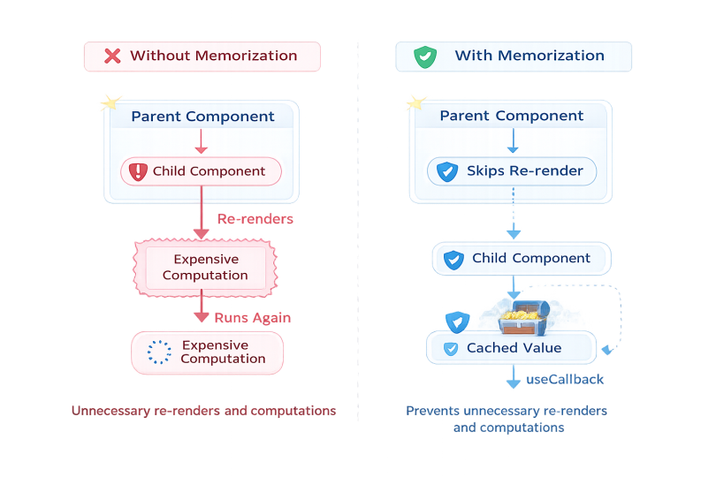
Memoization Techniques
useMemo
useCallback
React.memo
Use for expensive calculations and stable props
Avoid premature optimization

Slide 12
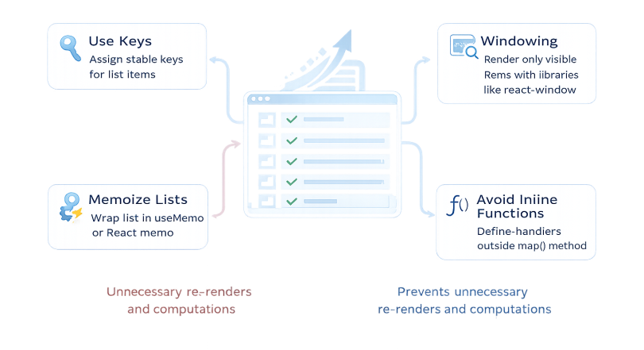
List & Rendering Optimization
Proper key usage
Avoid inline functions in large lists
Component render boundaries
Virtualization for large datasets

Slide 13
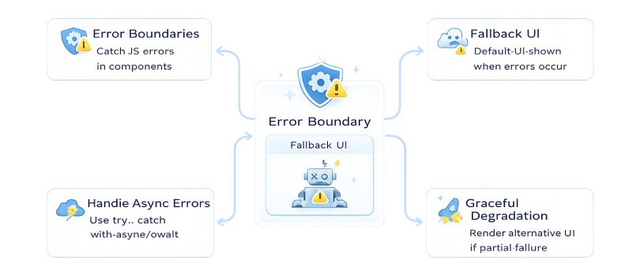
Error Handling & Resilience
Error boundaries
Fallback UI
Prevent full application crashes
Improve user trust & stability

Slide 14
Architecture for Maintainability
Feature-based folder structure
Separation of UI, logic, and data
Avoid large multi-responsibility components

Slide 15
Common Anti-Patterns
Excessive global state
Business logic inside JSX
Premature memoization
Overly complex abstractions
Deep prop drilling

Slide 16
Real-World Takeaways
Patterns are tools, not rules
Maintainability > cleverness
Optimize based on evidence
Small architectural decisions scale

Slide 17
Closing & Q&A
Scalable React is built through consistent decisions
Knowledge sharing improves engineering quality
Questions & Discussion

